Slide 1
Concepts of Operating Systems
Atul Kahate

Slide 2
Session 1: Introduction to Operating Systems

Slide 3

Computer Basics
Processing
Input
Output

Slide 4

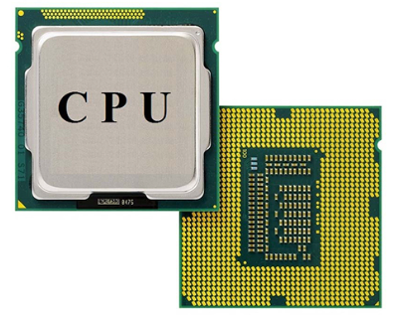
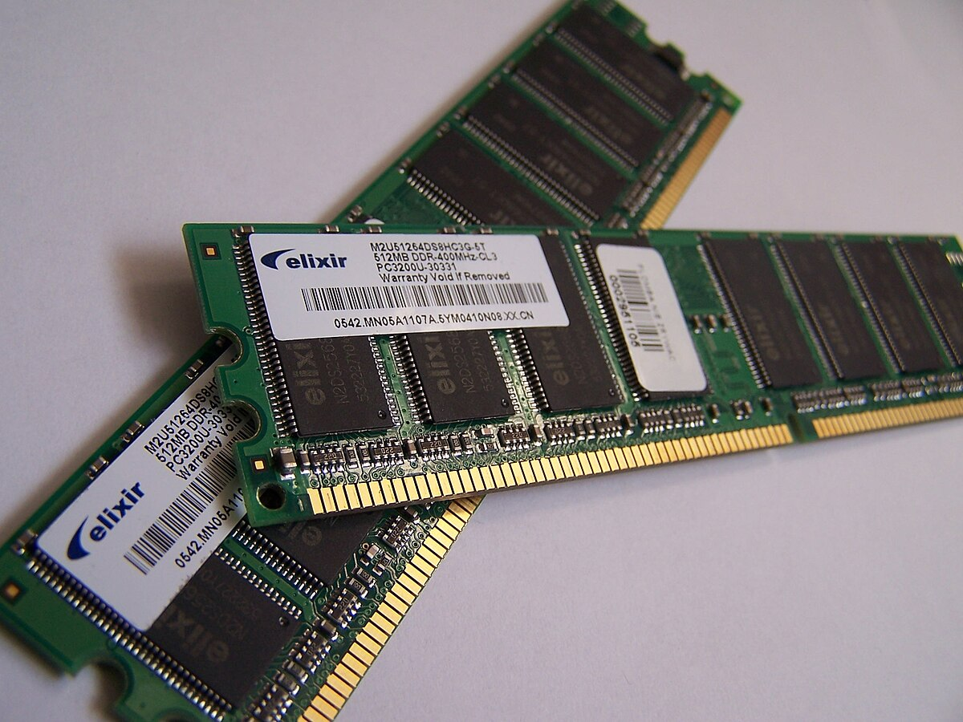
Main Components
Memory subsystem
Input/Output subsystem
Central Processing Unit

Slide 5
Program Execution
Disk
Main memory
CPU
Input
Program code read from the disk
Stored program
Execution
Output

Slide 6
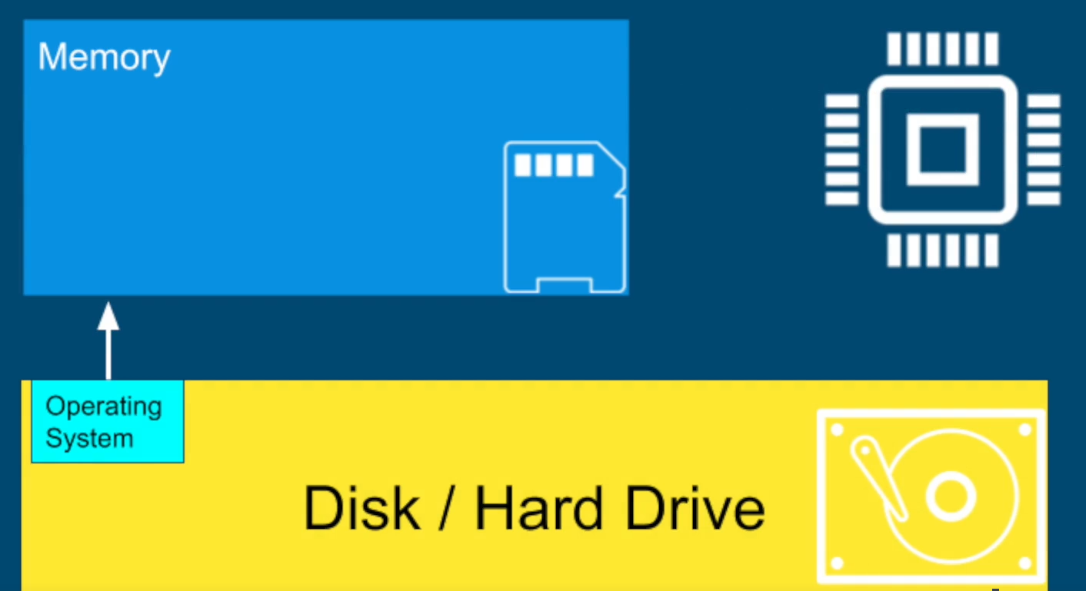
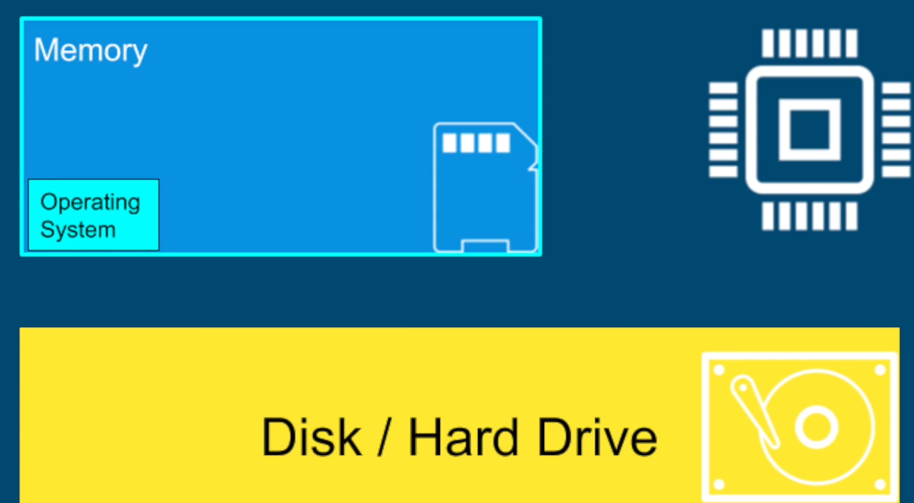
Why Operating Systems?
When we start our computer, a special program called operating system is loaded from the disk into the main memory (RAM) of the computer

Slide 7
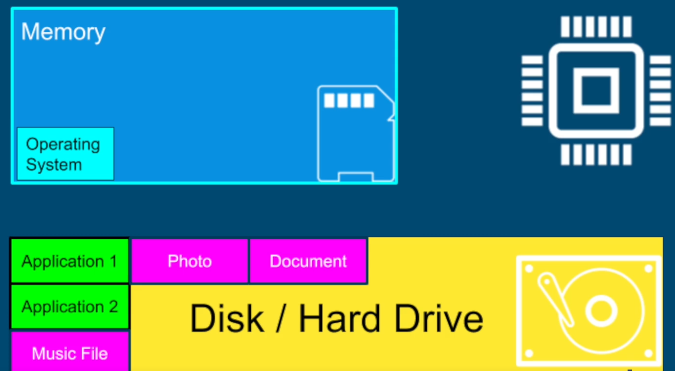
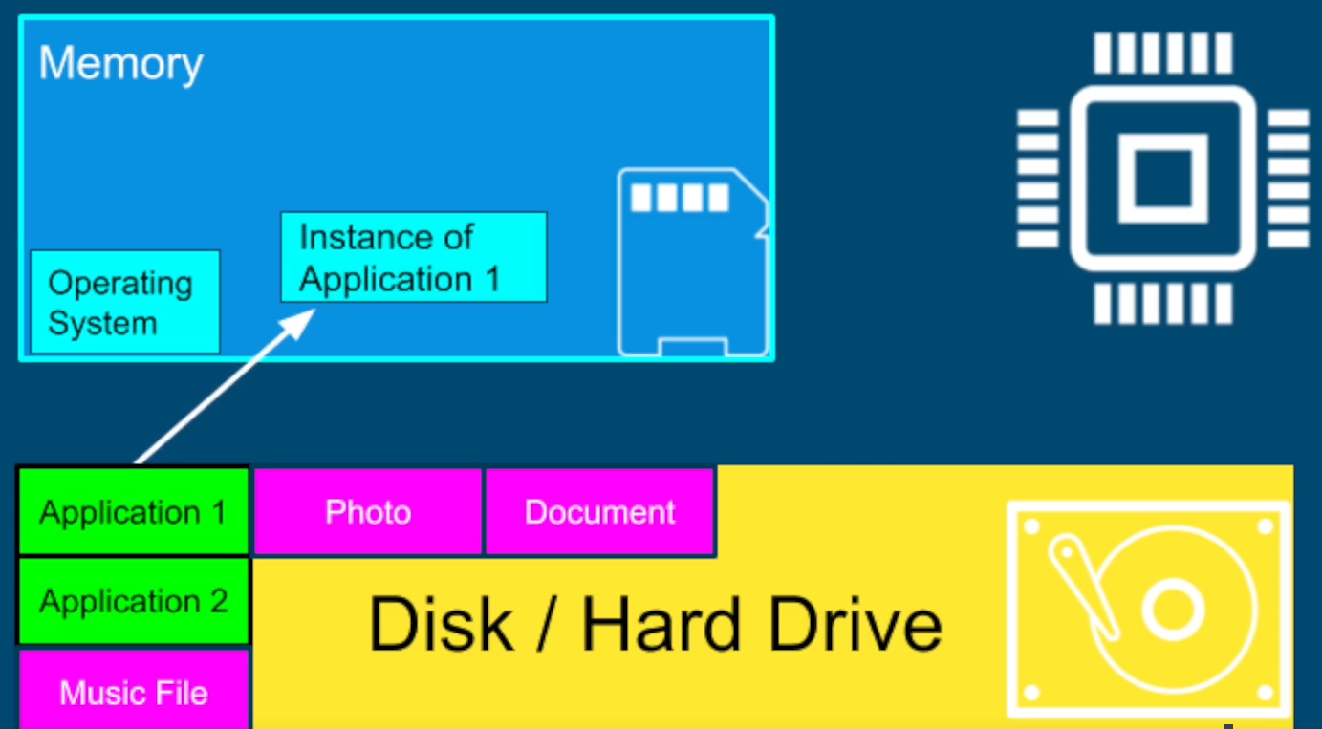
Why Operating Systems?
All our applications are on the disk in the form of files
When we run an application, it is loaded by the operating system into the main memory

Slide 8



Program and Process
Ground
Pavilion

Slide 9
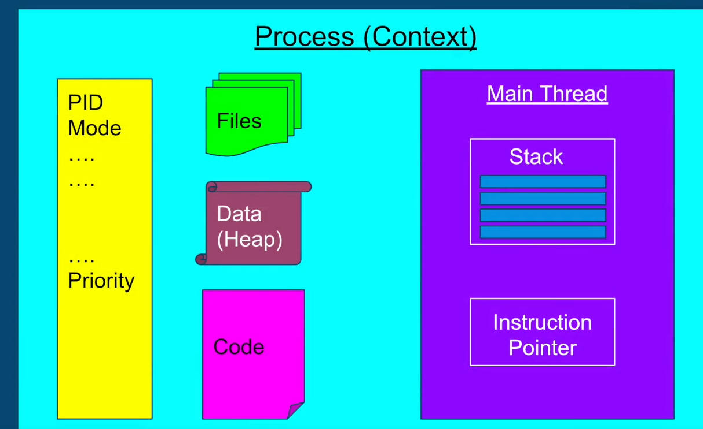
Why Operating Systems?
The instance of a program is a process

Slide 10
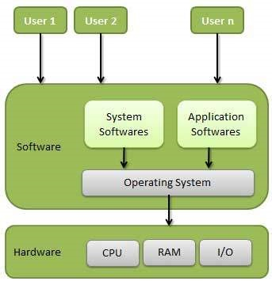
Introduction to OS Concepts
Operating System (OS): A program that acts as an bridge between a user and the computer hardware
Operating system goals:
Execute user programs and make solving user problems easier
Make the computer system convenient to use
Use the computer hardware in an efficient manner

Slide 11
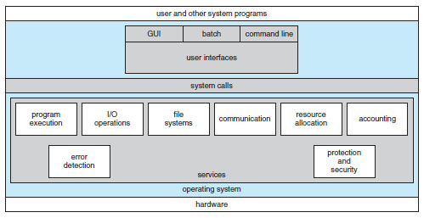
Different Components of an OS

Slide 12
Examples of OS
Mobile OS: Android, iOS
Embedded Systems OS: Embedded Linux, QNX, VxWorks – Generally work on microwave ovens, TV, DVD, MP3 players, etc – Embedded in ROM
Real-time OS: eCos - Deadline-based work, Controlling machines, Welding robots, etc
Desktop OS: Windows, Linux, Mac – General-purpose OS
Server machine OS: Windows server/Linux server – Need to handle client-requests, load, security

Slide 13
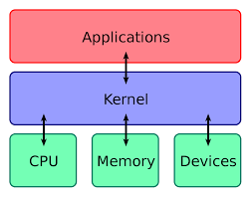
Kernel
“The one program running at all times on the computer” is the kernel
Everything else is either a system program (ships with the operating system) or an application program

Slide 14
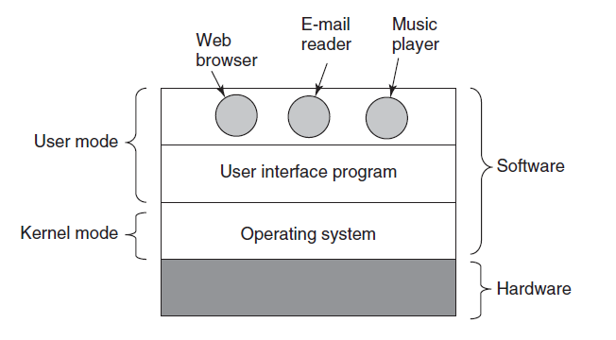
User Mode and Kernel Mode

Slide 15
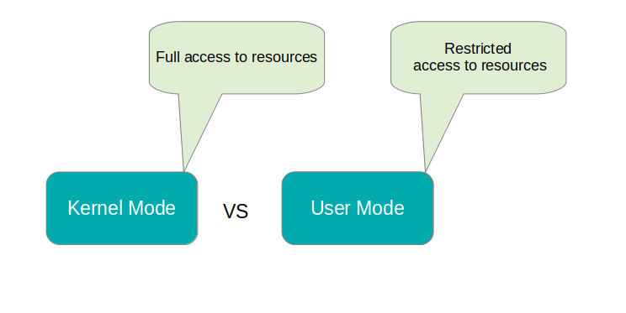
User Mode and Kernel Mode
User mode
Restricted access to resources
If a resource such as disk or file is needed, a signal is sent to the CPU via an interrupt to switch to the kernel mode
Kernel mode (also called as supervisor mode)
Full access to memory, I/O, and other resources

Slide 16
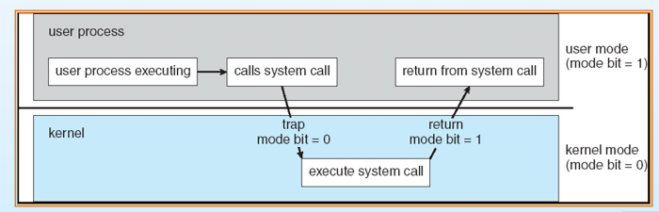
User Mode to Kernel Mode Transition
When the process is executing in the user mode, its user mode bit = 1
When it executes a system call to enter kernel mode, its user mode bit = 0
At the end of the system call, when the process returns to the user mode, its user mode bit = 1

Slide 17
Interrupt
Situation: A process in the user mode needs to execute some instruction in the kernel mode
Action: It needs to switch from user mode to kernel mode
How to do?: It generates an interrupt and makes a system call

Slide 18
Session 2: Introduction to Linux

Slide 19
Linux History
Linux: World’s most widely used operating system
Open source
Created by Linus Torvalds in 1991

Slide 20
Installing Linux – Multiple Options
On a Windows machine, install WSL (Simplest and light-weight)
https://learn.microsoft.com/en-us/windows/wsl/install
Use a virtual machine and install a Linux distribution
VMWare or Oracle VirtualBox (See https://techbland.com/how-to-install-lubuntu-on-virtualbox-on-windows/)
Create a dual-boot machine (Windows and Linux)

Slide 21

Linux Distributions (“Distros”)

Slide 22
Linux Command Line
Command line = Shell
Shell | Program Name | Description
Bourne shell | sh | Original shell program from AT&T, available on all UNIX systems
C shell | csh | Shell developed as a part of BSD UNIX
TC shell | tsh | Similar to csh, with some enhancements
Korn shell | ksh | AT&T’s improvement of the Bourne shell
Bourne Again Shell | bash | Shell distributed with Linux

Slide 23

The Shell Prompt
General format: username@machinename, followed by the current working directory, and a dollar sign
If we have a hash (#) at the end, instead of the dollar, the user has superuser/root privileges

Slide 24
Processes

Slide 25
Linux Processes
List all processes: ps
If we run the command again, we will again see the same two processes, but the PID for ps process would be different
To get help about all the options: ps --help all
Now try ps -e
The ps command shows processes for the current user only, but ps -e or ps -A shows all the processes running on the computer
top command: Shows dynamic list of processes and the resources they are consuming

Slide 26
Killing a Process
Reduce the terminal size of top command to half and open a second terminal in the second half
Note the pid of the top process
In the other terminal, try kill <pid>
This sends a SIGTERM to top process, killing it

Slide 27
Data Streams and Piping
Process
STDOUT
STDIN
Every process has three data streams
ls– output is produced by STDOUT
mkdir (with no arguments) – error is produced by STDERR
echo “Hello CDAC” > test.txt – Input is produced by STDINPUT
echo "Hello CDAC!" | cat > hello.txt – Write the text to the file
The pipe (|) symbol sends the output of one command to the next
The greater than (>) symbol redirects STDOUT to a file
STDERR

Slide 28
File and Directory Management

Slide 29
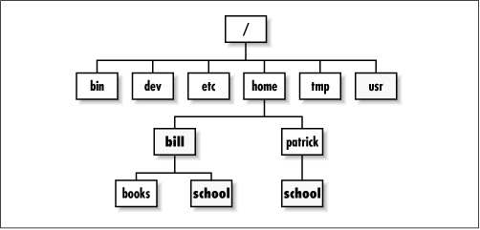
Directory Structure
/ is the root directory
Each user on the system has a sub-directory inside home
The tilda symbol (~) represents the user’s home directory

Slide 30
File and Directory Commands
touch: Create an empty file
pwd: Print Working Directory
cd: Change directory
Absolute path: Start from root – cd /home/atul/Downloads
Relative path: Start from current position – cd .. or cd test
Go to root: cd /
Go to user’s home directory: cd
Note: . is the current directory and .. Is the parent directory
ls: List all files in a specified directory
mkdir: Create a directory
cp: Copy files and directories
mv: Rename a file/directory
rm: Delete a file, rm -r: Recursively delete a directory and all sub-directories

Slide 31
Linux Editors
vi – The original Linux editor
vim – Improved version of vi
nano – Easy to work with (To install: sudo apt-get update and then sudo apt-get install nano)

Slide 32
The vi Editor
Modal editing: Three different modes: normal, insert, command-line
Normal mode: Navigate the file, Editing commands are possible
Insert mode: For inserting text
Command-line mode: Editor commands
Normal mode commands: Cursor movement using h (left), j (down), k (up), l (right), w (one word forward), b (one word back), gg (BOF), G (EOF)

Slide 33
Using vi
Problem: Create a file test.txt, add three lines, save and exit and again reopen the file and edit the second line, save and exit.
By default, vi starts in the normal mode, so press i to switch to insert mode and type three lines, then ESC, then type :wq and ENTER to save and exit
Then reopen the file, use j twice to move cursor down two lines, press i to switch to insert mode, again repeat ESC :wq ENTER
To quit vi without saving the changes, ESC :q! ENTER
To display line numbers in vi, ESC :set number ENTER

Slide 34
Moving First Three Lines of a File to its End in vi
Once inside vi, press the Esc key to ensure you are in command mode.
Move the cursor to the beginning of the file by pressing gg.
Enter visual mode by typing V (uppercase V).
Move the cursor down to select the first three lines by pressing 3j or simply 3↓.
Once the lines are selected, cut them by typing d.
Move to the end of the file by typing G.
Paste the cut lines by typing p.

Slide 35
Copy the 5th line and paste it above the first line in vi
Once inside vi, press the Esc key to ensure you are in command mode.
Move the cursor to the 5th line by typing 5G or simply 5gg.
Enter visual mode by typing V (uppercase V).
Move the cursor down to select the entire 5th line by pressing j or ↓.
Once the line is selected, copy it by typing y.
Move to the first line by typing gg.
Paste the copied line above the first line by typing P (uppercase P).

Slide 36
Find and Replace in vi
Forward search cdac: ESC and then /cdac (n to go to the next occurrence, N to go to the previous occurrence)
Backward search cdac: ESC and then ?cdac (n to go to the previous occurrence, N to go to the next occurrence)
Replace abc with xyz: ESC and then :%s/abc/xyz/g
Note: g = global, if omitted, it will replace only the first occurrence

Slide 37
Counting Number of Lines in a File, etc
The word count (wc) command
Find out number of lines, words, bytes and characters in a file
Create two files: state.txt and capital.txt
Andhra Pradesh
Arunachal Pradesh
Assam
Bihar
Chhattisgarh
Amaravati
Itanagar
Dispur
Patna
Raipur

Slide 38
Counting Number of Lines in a File, etc
Andhra Pradesh
Arunachal Pradesh
Assam
Bihar
Chhattisgarh
wc state.txt
5 7 58 state.txt
wc state.txt capital.txt
5 7 58 state.txt
5 5 39 capital.txt
10 12 97 total
wc -l state.txt
5 state.txt
wc -w state.txt capital.txt
7 state.txt
5 capital.txt
12 total
Number of lines
Amaravati
Itanagar
Dispur
Patna
Raipur
Number of words

Slide 39
Counting Number of Lines in a File, etc
wc -c state.txt
58 state.txt
ls | wc -l
17
Andhra Pradesh
Arunachal Pradesh
Assam
Bihar
Chhattisgarh
Number of bytes
Number of files and directories in the current directory
Amaravati
Itanagar
Dispur
Patna
Raipur

Slide 40
File inode and links
inode (index node): A data structure that stores metadata about a file or directory
File type (Regular, Directory, Link), Permissions, Owner and Group, Size, Timestamps, Pointers to data blocks, Link count
Link: Association between a file name and its inode
Hard link: Directory entry (File name->inode), If multiple, then multiple directory entries -> One file, Changes made through one -> Reflect everywhere
Soft link or Symbolic link (symlink): A special type of file that contains a reference to another file, Does not point to inode but to the path of the file

Slide 41
Example
Create a file using echo: echo "This is some text." > FILE2
Create two more hard links to the file:
ln FILE2 FILE2_hardlink1
ln FILE2 FILE2_hardlink2
Now, we have three hard links to the same file: FILE2, FILE2_hardlink1, and FILE2_hardlink2
Check the inode number and link count for each of these names:
ls -i -l FILE2 FILE2_hardlink1 FILE2_hardlink2

Slide 42
The who Command
Display all users: who
Possible question: Combine the outputs of the who and pwd commands:
who && pwd
The && operator chains multiple commands, second runs only if the first one succeeds

Slide 43
The date Command
date: Display the system date
Question: Display the system date in following format: Today is Friday, 17 May 96
date +"Today is %A, %d %B %y"
%A: Full weekday name (e.g., Monday, Tuesday)
%d: Day of the month (01 to 31)
%B: Full month name (e.g., January, February)
%y: Year without century (00 to 99)

Slide 44
Examples
Question | Command | Key points
List all the files and sub directories of the directory /bin. | ls -la /bin | -l = Long listing, -a = All files, including hidden files
List all the files including hidden files in your current directory. | ls -la
List all the files starting with letter ‘r’ in your current directory. | ls r*
List all the files having three characters in their names, from your current directory. | ls ??? | ? wildcard = Exactly one character
List all the files with extension .doc in your current directory. | ls *.doc
List all the files having the first letter of their name within the range ‘l’ to ‘s’, from your current directory. | ls [l-s]* | * = Any number of any characters
Create a file text1 and read its input from keyboard. | echo "Type your input here:" > text1 cat >> text1 | Press ENTER and Ctrl+D to terminate. The >> redirection operator directs the output of a command to the end of a file

Slide 45
Examples
Question | Command | Key points
Copy the contents of file text1 to another file text2. | cp text1 text2
Append the contents of file text2 to file text1. | cat text2 >> text1
Count the number of files in the current directory. | ls -l | grep "^-" | wc -l | grep "^-": Filters out only the lines that represent regular files (not directories or other types of files). In the long format, the lines representing regular files start with -. wc -l: Counts the number of lines.
Display the output of command ls –l to a file and on the output screen. | ls -l | tee ls_output.txt | tee command reads from standard input and writes to standard output and files simultaneously.
From file text1 print all lines starting from 10th line. | tail -n +10 text1 | tail = Display EOF, -n: How many lines?, +10: Start from the 10th line (If we use 10, it will be the last 10 lines)

Slide 46
Examples
Question | Command | Key points
Find the number of users currently logged on to the system. | who who | wc -l | wc -l will give number of users, since it will count the lines of the output of the who command
Delete all the files with their names starting with “tmp”. | rm tmp*

Slide 47
su and sudo Commands
Linux is very strict about what users can do
Ordinary users can work in their home directory and can perform operations related to their own work
Many Linux operations require elevated (higher) privileges: Two commands can be used for this
sudo: Superuser Do: Execute a command as the superuser – Own password is needed
Example: Update system package list: sudo apt update … apt = Advanced Package Tool
su: Switch User: Switch the current user to another user (If no name is specified, switch to root) – Target user’s password is required
Example: su - to switch to the root user and then exit to return to the previous user

Slide 48
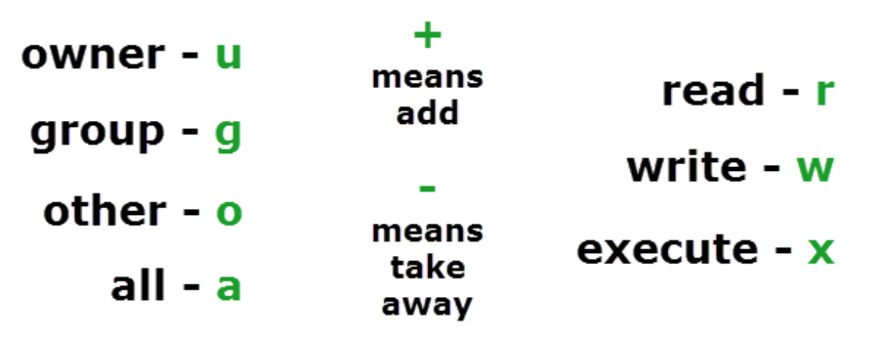
File Permissions

Slide 49
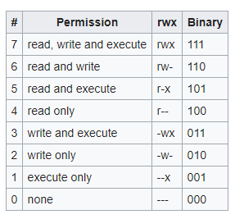
Numeric File Permissions

Slide 50
User and Group Concepts
Group: Concept to manage permissions for files and resources better
A user belongs to at least one group
Find which groups you belong to: Use the groups command
When we create a new user, a group with the user name is also created and the user is a part of that group
The user may also be a part of other groups
Create a new user: sudo adduser cdac … or useradd on some distros
Create a new group: sudo groupadd teamA
Add a user to this group: sudo usermod -aG teamA cdac
-a: Do not remove this user from other groups
-G: Groups to which the user should be added
To grant the user superuser privileges: sudo usermod -aG sudo cdac
Remove this user from the group: sudo gpasswd -d cdac teamA

Slide 51
The chmod command
chmod 755 file1: rwx for user, rx and group, rx for others
chmod 525 file1: rx for owner, w to group, rx for others
chmod u+x file1: Add execute permission to user
chmod g-w file1: Remove write permission from group
chmod u+x,g+r test.txt: Add execute permission to user, read permission to group

Slide 52
The Global Regular Expression Print (grep) Command
Search for specific patterns (regular expressions) in text
grep CDAC hello.txt Search for the word CDAC in hello.txt file
ls | grep ct List files whose name contains ct anywhere
ls | grep ^Pi List files whose name starts with Pi
ls | grep es$ List files whose name ends with es

Slide 53
Past Exam Question
Count the number of lines in file “cdac-sylabus.txt” which has word “JAVA” in that line.
Note: The word should not have any prefix or suffix. Eg “EBJAVA” or “JAVAB” should be excluded while getting the counts for “JAVA”
grep -c "\<JAVA\>" "cdac-syllabus.txt"

Slide 54
find Command
Search for files and directories
Find a file based on its name: find -name one.txt
Find all files with extension .txt: find -type f -name "*.txt“
Find all files with size > 10kb: find -type f -size +10k
Same, but also see the actual size > 10kb: find -type f -size +10k –ls
Find directories with permission 755: find -type d -perm 755 -ls

Slide 55
Additional Commands With the find Command
find -name "*.txt" -exec cat {} \;
Find all the files with extension and display their contents one by one
-exec cat {} \; runs like a loop for each .txt file, {} getting replaced with the file name and finally \; indicating the end of exec

Slide 56
Problems: find Command
Problem | Command
Files with extension .c or .pl | find . -type f \( -name "*.c" -o -name "*.pl" \)
Directories having permission 755 | find . -type d -perm 755
Files having permission 655 | find . -type f -perm 655
Files having inode number 12122 | find . -type f -inum 12122
Files which have not been accessed for more than a year and save the list in Old_File | find . -type f -atime +365 -print > Old_File
Files whose size is greater than 1024 bytes | find . -type f -size +1024c

Slide 57
Shell Scripts

Slide 58
What is a Shell Script?
Shell script: A file containing a series of commands
Examples:
echo “5/2” | bc
echo “scale=2; 5/2” | bc
echo “scale=10; 5/2” | bc
name=“Linux Student”
echo $name > out.txt

Slide 59
PS Variables
Prompt Statement Environment Variables
PS1: Default interaction prompt
PS2: Continuation interaction prompt
PS3: Prompt used by the select statement inside a script

Slide 60
PS1: Default Interaction Prompt
Try this command: export PS1="\u@\h \w> “
The default prompt will be changed to show the user name, home, and working directory
export PS1="\u\w:\d-\t>"
PS1="\$(date +%d.%m.%Y) > "
export PS1
PS1="\D{%F %T}>“
export PS1="\u@\h [\$(date +%k:%M:%S)]> "

Slide 61
PS2
For incomplete commands, shell will display a secondary prompt as > and wait to complete the command and hit Enter again
Example:
echo “this is a
> test”
PS2=“continue …”
echo “this is a
continue... test”

Slide 62

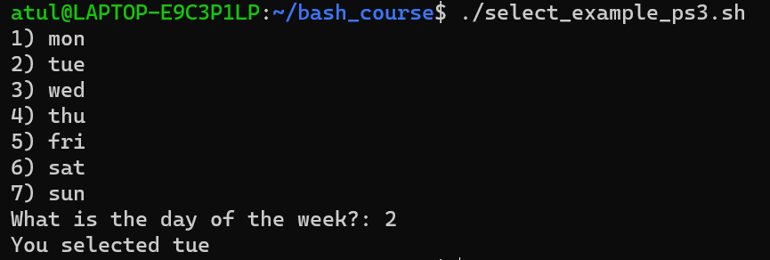
The select Command and the PS3 (Prompt for Select command) Variable
Called ‘Shebang’ or ‘Shabang’ operator, because:
# means sharp (as in C#)
! In comics is used as Bang!
select_example_ps3.sh
#!/bin/bash
PS3="What is the day of the week?: "
select day in mon tue wed thu fri sat sun;
do
echo "You selected $day"
break
done

Slide 63
Variables
User-defined variables
INSTITUTE=“ACTS”
echo “Hello $INSTITUTE”
Shell variables
echo "Home directory: $HOME"
echo "Username: $USER"
echo "Current directory: $PWD"
echo "Process ID: $$“
Display the following text message on the monitor screen.
Deposited $100 to you account: echo "Deposited \$100 to your account"
We need to use \ as escape character here

Slide 64
Wildcards
Wildcards help us create patterns for searching in shell commands
They are used to match text or string data
There are three main wildcard characters: * ? []

Slide 65
Wildcards
Character | Use | Example
Star or asterisk (*) | Search for specific characters 0 or more times | ls a* will search for all files in the current directory whose names start with a
Question mark (?) | Search for fixed number of characters, where one ? Represents one character | ls ???t.txt will search for all files in the current directory whose names are 4 characters long, end with t, and have an extension of txt
Square brackets ([]) | Match characters based on a range or in a group | ls hello.[t-z]* will search for all files in the current directory whose name is hello and extension is any number of any characters between t and z

Slide 66
Wildcard Examples
ls a* - List all files whose names start with a, file extension may or may not be there
ls a*.pqr - List all files whose names start with a, but file extension should be pqr
ls *.txt – Files that have extension txt
ls *.sh *.txt - Files that have extension txt or sh
ls Great*by.txt - Files whose name starts with Great, ends with by, and have extension txt
ls ?i* - Files whose names have i as the second character
ls *.??? – Files with any name, but exactly three characters in the extension
ls [sv]* - Files whose names begin with s or v
ls [s-v]* - Files whose names begin with any letter between s and v
ls *[0-9]* - Files whose names include at least one digit
ls [afgh]*o* - Files whose names start with a letter between and h and followed anywhere by letter o

Slide 67
Character Classes
We can use character classes to check for substrings or to do other comparisons
They are an alternative to the earlier wildcard syntax
Examples:
‘[:alpha:]’ instead of ‘[A-Za-z]’
‘[:lower:]’ instead of ‘[a-z]’
‘[:upper:]’ instead of ‘[A-Z]’
‘[:alphanum:]’ instead of ‘[0-9A-Za-z]’
‘[:digit:]’ instead of ‘[0-9]’
Note: If we are using these in bash commands, we need two square brackets – See next slide

Slide 68
Using Character Classes in Shell Commands
ls [:upper:]*.* - Will match any files that contain characters u p p e r in the file name – NOT WHAT WE WANT
We should write it as: ls [[:upper:]]*.*
Now we will get files whose names contain at least one upper case character

Slide 69
Regular Expressions
Wildcards and character codes can be used in regular expressions
Regular expressions allow us to check sub-strings, do exact string comparisons, etc
We will discuss this during Shell programming

Slide 70
Session 3: Shell Programming

Slide 71
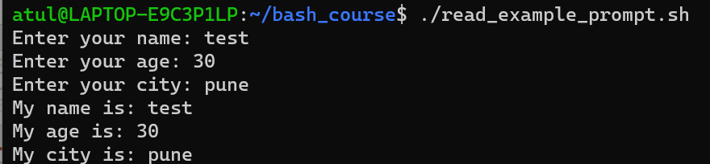
Variables
Other useful options
-t: Timeout in seconds
-s: Secret
read_example_prompt.sh
#!/bin/bash
read -p "Enter your name: " name
read -p "Enter your age: " age
read -p "Enter your city: " city
echo "My name is: $name"
echo "My age is: $age"
echo "My city is: $city"

Slide 72
Conditions – if Statement
#!/bin/sh
a=10
b=20
if [ $a -eq $b ]
then
echo “a is equal to b”
fi
if [ $a -ne $b ]
then
echo “a is not equal to b”
fi

Slide 73
Same Example using if-else
#!/bin/sh
a=10
b=20
if [ $a -eq $b ]
then
echo “a is equal to b”
else
echo “a is not equal to b”
fi

Slide 74
Check If a Number is Even or Odd
#!/bin/bash
read -p "Enter a number : " n
rem=$(( $n % 2 ))
# Other syntaxes
# let "rem = n % 2"
# rem=$(expr $n % 2)
# rem=$(echo "$n % 2" | bc)
if [ $rem -eq 0 ]
then
echo "$n is even number"
else
echo "$n is odd number"
fi

Slide 75
if-elif-else
#!/bin/bash
echo "Enter a Number"
read num
if [ $num -lt 0 ]
then
echo "Negative"
elif [ $num -gt 0 ]
then
echo "Positive"
else
echo "Neither Positive Nor Negative"
fi

Slide 76
Max of three numbers
#!/bin/bash
echo "Enter Num1"
read num1
echo "Enter Num2"
read num2
echo "Enter Num3"
read num3
# To accept multiple inputs: read num1 num2 num3
if [ $num1 -gt $num2 ] && [ $num1 -gt $num3 ]
then
echo $num1
elif [ $num2 -gt $num1 ] && [ $num2 -gt $num3 ]
then
echo $num2
else
echo $num3
fi

Slide 77
String Comparison
#!/bin/bash
# Shell script to check whether two
# input strings is equal
# take user input
echo "Enter string a : "
read a
echo "Enter string b : "
read b
# check equality of input
if [ "$a" == "$b" ]; then
# if equal print equal
echo "Strings are equal."
else
# if not equal
echo "Strings are not equal."
fi

Slide 78
Calculate Average using Bash Calculator
#!/bin/bash
read -p "Enter marks in subject 1: " marks1
read -p "Enter marks in subject 2: " marks2
read -p "Enter marks in subject 3: " marks3
total=$(( $marks1 + $marks2 + $marks3 ))
echo "Total marks: $total"
avg=$( echo "scale=4; $total / 3" | bc )
echo "Average marks: $avg"

Slide 79
Input Must Have All Alphabets
=~ is an operator in Bash to compare a string with a regular expression pattern
^ indicates start of the string
+ indicates one or more characters
$ indicates end of the string
#!/bin/bash
read -p "Enter a string: " input_string
if [[ $input_string =~ ^[[:alpha:]]+$ ]]; then
echo "Input contains only alphabetic characters."
else
echo "Input contains non-alphabetic characters."
fi

Slide 80
Accept Only a 10-Digit Phone Number
#!/bin/bash
read -p "Enter a 10-digit number: " input
# Check if the input consists of exactly 10 digits using regex
if [[ $input =~ ^[0-9]{10}$ ]]; then
echo "Valid input: $input"
else
echo "Invalid input. Please enter a 10-digit number."
fi

Slide 81
Shell Program Containing Many File Operations
#!/bin/bash
# Create a directory if it doesn't exist
if [ ! -d "my_directory" ]; then
mkdir my_directory
echo "Directory 'my_directory' created."
fi
# Move into the directory
cd my_directory
# Create a new file
echo "Hello, world!" > my_file.txt
echo "Contents written to 'my_file.txt'."
# Display file content
echo "Contents of 'my_file.txt':"
cat my_file.txt
# Append to the file
echo "Appending more text." >> my_file.txt
echo "Additional content appended."
# Display file content again
echo "Contents of 'my_file.txt' after appending:"
cat my_file.txt
# Copy the file
cp my_file.txt my_file_copy.txt
echo "'my_file.txt' copied to 'my_file_copy.txt'."
# Rename the file
mv my_file_copy.txt my_new_file.txt
echo "'my_file_copy.txt' renamed to 'my_new_file.txt'."
# Check if a file exists
if [ -e "my_new_file.txt" ]; then
echo "'my_new_file.txt' exists."
fi
# Delete the original file
rm my_file.txt
echo "'my_file.txt' deleted."
# List files in the directory
echo "Files in the directory:"
ls
# Move out of the directory
cd ..
# Remove the directory and its contents
rm -r my_directory
echo "Directory 'my_directory' and its contents removed."

Slide 82
C-Style for Loop
#!/bin/bash
# testing the C-style for loop – double brackets are needed
for (( i=1; i <= 10; i++ ))
do
echo "The next number is $i"
done

Slide 83
while Command
#!/bin/bash
# while command test
var1=10
while [ $var1 -gt 0 ]
do
echo $var1
var1=$[ $var1 - 1 ]
done

Slide 84
break Example
#!/bin/bash
# breaking out of a for loop
for var1 in 1 2 3 4 5 6 7 8 9 10
do
if [ $var1 -eq 5 ]
then
break
fi
echo "Iteration number: $var1"
done
echo "The for loop is completed"

Slide 85
Problems and Solutions
1. List only the directories in your current directory
ls -d */ | wc -l
2. Display the name and count of the directories in the current directory.
ls -d */ | wc -l
3. Find out whether the users with a pattern“itp9” in their names have logged in ?
who | grep 'itp9'
4. Find out whether a particular user “itp9” has logged in ?
who | grep -w 'itp9'
5. Assign a value “Black” to var1 and then display the following message on the terminal using this variable: Black belt is associated with karate
var1="Black"
echo "${var1} belt is associated with karate"

Slide 86
Problems and Solutions
Create the file employee.txt having colon (: ) separated fields. The fields of the record are: enumber, ename, eposition, esal, edoj, edept. And now answer the following:
List all the employees along with a row number
Sort the file as per the names
List top three salaried employees
Remove duplicate records from the file
List dept. no along with no. of employees working in each dept.
Sort the file in descending order of salary
a. nl employee.txt
b. sort -t':' -k2 employee.txt
c. sort -t':' -k4nr employee.txt | head -n 3
d. sort -u -t':' -k1,1 employee.txt
e. while IFS=':' read -r _ _ _ _ _ edept; do
echo "$edept"
done < employee.txt | sort | uniq -c
f. sort -t':' -k4nr employee.txt

Slide 87
Problems and Solutions
Accept a file name and a number (x). Display x lines from the top of the file.
Check if the file exists and is readable. The value of x should not exceed the total number of lines in the files. Display suitable messages in case an error is encountered.

Slide 88
Problems and Solutions
#!/bin/bash
# Function to display usage message
usage() {
echo "Usage: $0 <file_name> <number_of_lines>"
}
# Check if correct number of arguments are provided
if [ "$#" -ne 2 ]; then
usage
exit 1
fi
# Assign command line arguments to variables
file_name="$1"
number_of_lines="$2"
# Check if file exists and is readable
if [ ! -r "$file_name" ]; then
echo "Error: File '$file_name' does not exist or is not readable."
exit 1
fi
# Check if number of lines is not greater than total lines in the file
total_lines=$(wc -l < "$file_name")
if [ "$number_of_lines" -gt "$total_lines" ]; then
echo "Error: Number of lines provided exceeds total lines in the file ('$total_lines')."
exit 1
fi
# Display x lines from the top of the file
head -n "$number_of_lines" "$file_name"

Slide 89
Problems and Solutions
Write a menu based script which displays the following options :
Accept roll number, name, marks in sub1, sub2 and sub3. Calculate total, percentage, grade & class and enter the record in a file “student”. The marks are out of 100 in each subject. Allow the user to enter any number of records.
Grade is found out as follows :
Percentage Grade
< 35 Fail
>= 35 & < 50 Third
>= 50 & < 60 Second
>= 60 & < 75 First
>= 75 Distn
If the student secures < 35 in any one of the subjects, then class = “fail”. Otherwise
class=”pass”.

Slide 90
Problems and Solutions
#!/bin/bash
# Function to calculate grade based on percentage
calculate_grade() {
if (( $1 < 35 )); then
grade="Fail"
elif (( $1 >= 35 && $1 < 50 )); then
grade="Third"
elif (( $1 >= 50 && $1 < 60 )); then
grade="Second"
elif (( $1 >= 60 && $1 < 75 )); then
grade="First"
else
grade="Distn"
fi
}
# Function to calculate class
calculate_class() {
if (( $1 < 35 || $2 < 35 || $3 < 35 )); then
class="Fail"
else
class="Pass"
fi
}
# Function to display menu
display_menu() {
echo "Menu:"
echo "1. Enter Student Record"
echo "2. Display Student Records"
echo "3. Exit"
}
# Function to enter student record
enter_record() {
echo "Enter Roll Number:"
read roll_number
echo "Enter Name:"
read name
echo "Enter Marks in Subject 1:"
read sub1
echo "Enter Marks in Subject 2:"
read sub2
echo "Enter Marks in Subject 3:"
read sub3
# Calculate total marks and percentage
total=$((sub1 + sub2 + sub3))
percentage=$((total / 3))
# Calculate grade and class
calculate_grade $percentage
calculate_class $sub1 $sub2 $sub3
# Write record to file
echo "$roll_number $name $sub1 $sub2 $sub3 $total $percentage $grade $class" >> student
echo "Record added successfully."
}
# Function to display student records
display_records() {
echo "Roll Number | Name | Sub1 | Sub2 | Sub3 | Total | Percentage | Grade | Class"
echo "---------------------------------------------------------------------------"
cat student
}
# Main script
while true; do
display_menu
read -p "Enter your choice: " choice
case $choice in
1) enter_record ;;
2) display_records ;;
3) echo "Exiting program."; exit ;;
*) echo "Invalid choice. Please enter a valid option." ;;
esac
done

Slide 91
Problems and Solutions
Accept roll number from the user at the command line. Search it in the “student” file. If it is present, then display name, percentage, grade and class of the student. If the roll number is not present, then display a message “not found”. Allow the user to enter any number of queries.

Slide 92
Problems and Solutions
#!/bin/bash
# Function to search for roll number in student file
search_roll_number() {
roll_number="$1"
found=false
while read -r line; do
rno=$(echo "$line" | cut -d ' ' -f 1)
if [[ "$rno" == "$roll_number" ]]; then
found=true
name=$(echo "$line" | cut -d ' ' -f 2)
percentage=$(echo "$line" | cut -d ' ' -f 7)
grade=$(echo "$line" | cut -d ' ' -f 8)
class=$(echo "$line" | cut -d ' ' -f 9)
echo "Roll Number: $roll_number"
echo "Name: $name"
echo "Percentage: $percentage"
echo "Grade: $grade"
echo "Class: $class"
break
fi
done < student
if [ "$found" == "false" ]; then
echo "Roll number $roll_number not found."
fi
}
# Check if a roll number was provided as argument
if [ "$#" -ne 1 ]; then
echo "Usage: $0 <roll_number>"
exit 1
fi
# Call search function with provided roll number
search_roll_number "$1"

Slide 93
Past Lab Exam Question
Write a bash script to take input string from user. Print output as follows.
a) If all the characters in input string is upper case, print “Input String is in UPPER case”
b) If all the characters in input string is lower case, print “Input String is in LOWER case”
c) else print “Input String is in MIXED case”

Slide 94
Past Lab Exam Question
Note: Some shells allow the = operator to be used for string comparison instead of ==, but it is not recommended.
We should use = for assignment and == for comparison.
Example:
my_variable="Hello"
and
if [ "$string1" == "$string2" ]; then
echo "Strings are equal.“
fi
#!/bin/bash
echo "Please enter a string: "
read input
# Check if the input is all uppercase
if [[ $input == [A-Z]* ]]; then
echo "The input is in all uppercase."
# Check if the input is all lowercase
elif [[ $input == [a-z]* ]]; then
echo "The input is in all lowercase."
# If it's not all uppercase or all lowercase, it must be mixed case
else
echo "The input is in mixed case."
fi

Slide 95
Past Lab Exam Question
Write a bash script to take input Number as upper limit from user.
a) Print the PID of the current script
b) Print the Numbers in reverse till we reach zero
e.g: If the user enters 5, print the numbers as below in separate lines
5
4
3
2
1
c) Input Number range is greater than 1 and less than 100
d) If user inputs number less than 1 or more than 100 print message “Input Number is Out of range”

Slide 96
Past Lab Exam Question
$$ is a special shell variable that represents the PID of the current running script
#!/bin/bash
echo "Enter the upper limit:"
read num
if [ $num -lt 1 ] || [ $num -gt 100 ]
then
echo "Input Number is Out of range"
else
echo "PID of the current script: $$"
for (( i=$num; i>=1; i-- ))
do
echo $i
done
fi

Slide 97
Past Lab Exam Question
Write a bash script to take two input string from user. Print the output as follows
a) If the input string 1 and input String 2 matches, Print “The TWO STRING matches”. The match should not be case sensitive. Means Input String 1 is “SPARK” and input 2 string is “Spark”, still it should print “The TWO STRING matches”.
b) If the input string 1 and input String 2 does not match, Print “The TWO STRING DOES NOT match”

Slide 98
Past Lab Exam Question
#!/bin/bash
echo "Enter the first string:"
read str1
echo "Enter the second string:"
read str2
if [ "${str1,,}" == "${str2,,}" ]
then
echo "The TWO STRINGS MATCH"
else
echo "The TWO STRINGS DO NOT MATCH"
fi
"${str1,,}": converts the string to lowercase
==: checks if two strings are equal
"${input^^}“: converts the string to uppercase

Slide 99
Past Lab Exam Question: Another Solution for the Same Problem
#!/bin/bash
echo "Enter the first string:"
read string1
echo "Enter the second string:"
read string2
# Convert both strings to lowercase and compare
lowercase_string1=$(echo "$string1" | tr '[:upper:]' '[:lower:]')
lowercase_string2=$(echo "$string2" | tr '[:upper:]' '[:lower:]')
if [ "$lowercase_string1" == "$lowercase_string2" ]; then
echo "The strings are equal (case-insensitive)."
else
echo "The strings are not equal (case-insensitive)."
fi

Slide 100
sed
Stream editor, as opposed to a normal interactive editor
It is a text editor without an interface. You can use it from the command line to manipulate text in files and streams.
With sed you can do all of the following:
Select text
Substitute text
Add lines to text
Delete lines from text
Modify (or preserve) an original file

Slide 101
sed Example
echo "This is a test" | sed 's/test/big test/’
The echo command sends “This is a test” into sed using pipe symbol
The simple substitution rule (s = substitute) is applied
sed searches the input text for an occurrence of the first string (test) and replaces with the second (big test)
Output will be sent to the terminal window

Slide 102
sed Examples
Note: File contents are not changed, only output is changed.
Create python.txt
Python is a very popular language.
Python is easy to use. Python is easy to learn.
Python is a cross-platform language
sed '2 s/Python/perl/g' python.txt → Replacement in the second line, g means all the instances in that line (here, 2)
sed 's/Python/perl/g2' python.txt → Replace the second occurrence on every line, wherever there is a match
sed '1 s/Python/perl/' python.txt → Replace the first occurrence on the first line
sed '$s/Python/Bash/' python.txt → Replace the last line’s first occurrence

Slide 103
sed and Delete
Create os.txt
Windows
Linux
Android
OS
sed '/OS/d' os.txt → Delete lines containing the word OS
sed '/Linux/,+2d' os.txt → Delete line containing the word Linux and next two lines

Slide 104
sed and Insert
Create myfile
This is a test and I like this test.
This is the next line of the test script.
sed '2i\This is the inserted line.' myfile → Insert a new second line
sed '2a\This is the appended line.' myfile → Append a new line (Note the position of the new line)
i is before and a is after

Slide 105
View a Range of Lines
Create sedtest.txt
This is a demo text file.
It is an amazing file that will help us all.
The sed command is also great for stream editing.
Want to learn how to use the command?
This is another line in the file.
This is the third general line in the file.
This file is named as textfile.
This is a apple.
This is a orange.
sed -n '3,5p' sedtest.txt => Display lines between 3 and 5
sed '3,5p' sedtest.txt => Display lines between 3 and 5
sed ‘3,5d' sedtest.txt => Display lines other than between 3 and 5
The -n flag prevents sed from displaying the pattern space at the end of each cycle.
The p argument stands for print and is used to display the matched lines to the user.
The d flag deletes the matched strings from the output and displays the rest of the content.

Slide 106
sed | More Examples
sed -n -e '1,2p' -e '5,6p' sedtest.txt => Display non-consecutive lines
The -e flag helps in executing multiple actions using a single command.
sed s/originalword/replaceword/g filename => Replace something
sed s/amazing/super/g sedtest.txt
The s argument denotes substitution and the g command is used to replace the matched content with the specified replacement content.

Slide 107
sed | More Examples
sed '2,5s/This/That/g’ sedtest.txt => Substitute words in a range of lines (2 to 5 in this example)
sed 's/amazing/super/g;s/command/utility/gi' textfile.txt => Multiple substitutions
sed -e '/orange/ s/a/an/g’ sedtest.txt
Replace the word a with an if the word orange is present in the line

Slide 108
Adding Users
sudo: Superuser Do: Execute a command as the superuser – Own password is needed
su: Switch User: Switch the current user to another user (If no name is specified, switch to root) – Target user’s password is required
The useradd and adduser command
Example: sudo useradd cdac
To allow the new user to login, we must set a password for the new user
Example: sudo passwd cdac
On some Linux distributions, the new user’s home directory is not automatically created, in which case, we need to use the following syntax
sudo useradd -m cdac
On Ubuntu, we can use a different command: sudo adduser cdac and to give the user admin privileges, sudo usermod -aG sudo cdac

Slide 109
Removing Users
The userdel and deluser command
Example: sudo deluser cdac
On Ubuntu, we can use a different command: sudo userdel cdac

Slide 110
Changing File Ownership
The chown command
Change the user and/or group ownership of a given file or directory
Example: sudo chown cdac test.txt
Verify by using the ls -l command

Slide 111
Past Lab Exam Questions
Convert all file names from upper case to lower case
for i in $( ls | grep [A-Z] ); do mv -i $i `echo $i | tr 'A-Z' 'a-z'`; done
Convert all file names from upper case to lower case and change .txt extension to .pdf
for i in $( ls | grep [A-Z] ); do mv -i $i `echo $i | tr 'A-Z' 'a-z'`; done | find . -depth -name "*.txt" -exec sh -c 'f="{}"; mv -- "$f" "${f%.txt}.pdf“’ \;
Alternative: Bash script – See next slide

Slide 112
Another solution
#!/bin/bash
echo "Enter the folder path:"
read folder_path
for file in "$folder_path"/*.txt; do
if [[ -f "$file" ]]; then
filename=$(basename -- "$file")
extension="${filename##*.}"
filename="${filename%.*}"
new_filename="${filename^^}.UPC"
mv -- "$file" "$folder_path/$new_filename"
fi
done

Slide 113
Past Lab Exam Question
What are the command to perform below tasks:
a) Rename a file from “application.jsp” to “application.html”
b) Find a process running with PID “2391”
c) Print the first 15 lines from file “content.txt”
d) Find files with name “java.cpp” within current folder or its subfolders
e) Create group as “tester”

Slide 114
Past Lab Exam Question
mv application.jsp application.html
ps -p 2391
head -n 15 content.txt
find . -name "java.cpp"
sudo groupadd tester

Slide 115
FTP, Telnet, etc

Slide 116
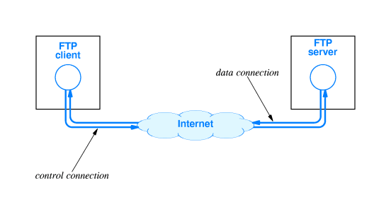
FTP Concept

Slide 117
FTP (File Transfer Protocol)
One of the earliest Internet protocols for file transfers
Allows downloading (server-to-client) or uploading (client-to-server) of files remotely
Made up of two parts
FTP server: Has files that can be downloaded, or it can also receive files from the users
FTP client: Downloads the require files from an FTP server, or it can upload files to the FTP server also

Slide 118
Setting up FTP Server on Ubuntu (on VirtualBox)
Step 1: A common open-source FTP utility used in Ubuntu is vsftpd.
sudo apt install vsftpd
Step 2: Start the FTP server
sudo systemctl start vsftpd
Step 3: Backup configuration files for safety
sudo cp /etc/vsftpd.conf /etc/vsftpd.conf_default

Slide 119
Setting up FTP Server on Ubuntu
Step 4: Create an FTP user, so that a client can access the FTP server
sudo useradd -m testuser
sudo passwd testuser
Step 5: Allow FTP through the firewall
sudo ufw allow 20/tcp
sudo ufw allow 21/tcp
Step 6: Connect to the FTP server locally
sudo ftp Ubuntu
(Here, Ubuntu is considered to be our Linux machine name, so replace it with the actual machine name)

Slide 120
Accessing the FTP Server from our Windows Machine
Open command prompt and type ftp
ftp> open
To 192.168.0.24 … This is the IP address of the Ubuntu machine – to find it, we can type ip a or ifconfig on the Ubuntu machine’s terminal
Connected to 192.168.0.24.
220 (vsFTPd 3.0.5)
200 Always in UTF8 mode.
User (192.168.0.24:(none)): testuser
331 Please specify the password.
Password:
230 Login successful.

Slide 121
Accessing the FTP Server from our Windows Machine
ftp> stat
Connected to 192.168.0.24.
Type: ascii; Verbose: On ; Bell: Off ; Prompting: On ; Globbing: On
Debugging: Off ; Hash mark printing: Off .
ftp> pwd
257 "/home/testuser" is the current directory
ftp> dir

Slide 122
Checking for Files
Create a file on the FTP server (i.e. Ubuntu machine)
atul@atul-virtualbox:~$ sudo su
root@atul-virtualbox:/home/atul# cd /home/testuser/
root@atul-virtualbox:/home/testuser# nano test.txt

Slide 123
Now Check in Windows FTP Client
ftp> pwd
257 "/home/testuser" is the current directory
ftp> dir
200 PORT command successful. Consider using PASV.
150 Here comes the directory listing.
-rw-r--r-- 1 0 0 14 Mar 23 19:10 test.txt
226 Directory send OK.
ftp: 69 bytes received in 0.01Seconds 8.63Kbytes/sec.

Slide 124
Download a File using FTP
ftp> get test.txt
200 PORT command successful. Consider using PASV.
150 Opening BINARY mode data connection for test.txt (14 bytes).
226 Transfer complete.
ftp: 14 bytes received in 0.00Seconds 14000.00Kbytes/sec.

Slide 125
Telnet and SSH
Telnet (Terminal + Network) is an Internet protocol for allowing a client computer to connect to a remote server computer and work on the server computer
Somewhat obsolete (outdated)
Now we generally use SSH (Secure Shell) instead of Telnet
SSH also allows a remote client computer to connect to a server over the Internet
Very useful in cloud computing

Slide 126
Setting up Telnet Server on Ubuntu
Step 1: Install Telnet server
sudo apt install telnetd -y
Step 2: Check the Telnet status
sudo systemctl status inetd
Step 3: Configure firewall for Telnet
sudo ufw enable
sudo ufw allow 23
Step 4: Test
telnet 192.168.0.24

Slide 127
Accessing Telnet from Windows
On the command prompt, type telnet
If you get an error, search for Turn Windows Features On/Off and enable Telnet there, then retry telnet
On the telnet prompt, o 192.168.0.24
User id: testuser, Password: testuser

Slide 128
Setting up SSH on Ubuntu Server
Step 1: Install SSH server
sudo apt install openssh-server
Step 2: Check the SSH status
sudo systemctl status ssh
Step 3: Configure firewall for SSH
sudo ufw allow ssh
Step 4: Restart if necessary
sudo service ssh restart

Slide 129
Access SSH using Putty
Download and install Putty (https://www.putty.org/)
Open Putty, enter IP address as 192.168.0.24 and connect
User id: testuser, Password: testuser

Slide 130
Process Management

Slide 131
Program and Process
Program (Passive, On the Disk)
Set of instructions to solve a problem, written in a programming language
Process (Active, in Memory)
When a program starts running, it becomes a process; which means the operating system has to track it
Execute

Slide 132
Process Concept
Process is a program in execution, Active
Program: Passive
Process needs resources to accomplish its task
CPU, memory, I/O, files
Initialization data
Process termination requires reclaim of any reusable resources
Many user processes, system processes run concurrently on one or more CPUs
How? Multiplexing the CPUs among the processes/threads

Slide 133
Registers
A register is the fastest type of memory, because a register is inside the CPU
A register is not in the main memory
All arithmetic and logical operations happen inside registers
The original Intel CPU had very few registers, e.g.
AX The accumulator register
BX The base address register
CX The counting register
DX The data register
IP Points to the next instruction to be executed (along with CS)
Flags Contains results of a comparison

Slide 134
Process
Process
Registers
Memory

Slide 135
Process versus Thread
“Heavy”
Has its own memory space
Runs completely independently
Has its own set of CPU registers
Other processes do not interfere with it

Slide 136
Process versus Thread
“Lightweight”
A thread is a part of a process
Every process has at least one thread
A process can run one thread or multiple threads
Threads share the process code, data, files
Each thread has its own stack and registers

Slide 137
Why Multithreading?
By default, programs are executed in sequence, line-by-line
public static void main (String args []) {
initialize ();
downloadData-1 ();
downloadData-2 ();
combine_results ();
}
Operation 1
In a single-threaded application, these will be executed one after another …
Operation 2
Operation 3
We can make it multi-threaded, so that time-consuming tasks do not block other tasks
Operation 4

Slide 138


Single Threaded Web Server
Web Server
Port 80

Slide 139
Multi-Threaded Web Server
Web Server
Port 80
Thread pool

Slide 140
Multi-Threaded Web Server – Apache Tomcat
Web Server
doGet()
abc.com/pay?acc=123&amt=45
Port 80
doGet()
doGet()
Thread pool

Slide 141
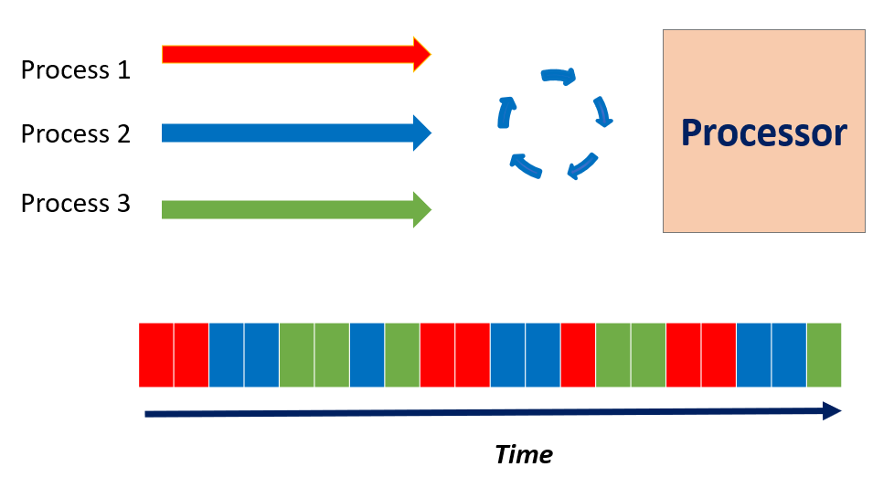
Many Processes, One Processor (CPU)

Slide 142
Process Management
Creating and deleting both user and system processes
Suspending and resuming processes
Process synchronization
Process communication
Deadlock handling

Slide 143
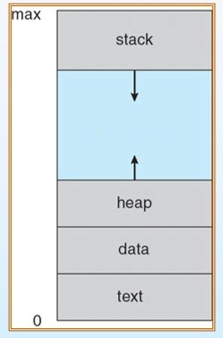
Process in Memory
A process includes:
program counter
stack
data section

Slide 144
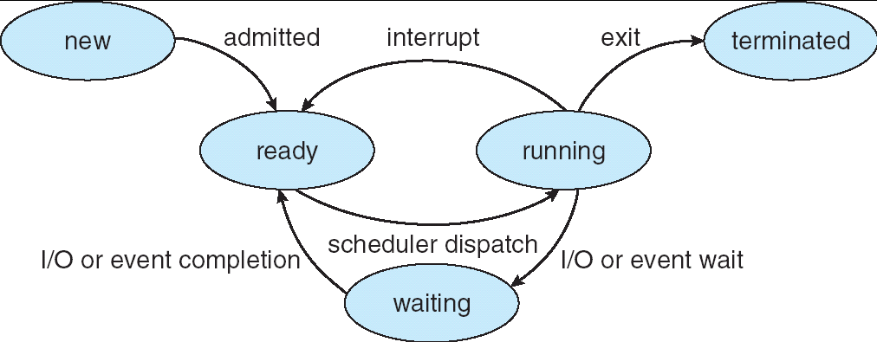
Process States
new: The process is being created
running: Instructions are being executed
waiting: The process is waiting for some event to occur
ready: The process is waiting to be assigned to a processor
terminated: The process has finished execution

Slide 145
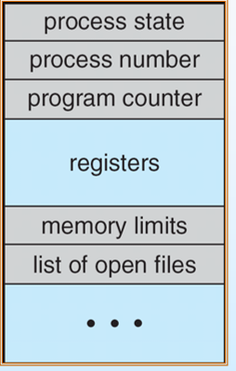
Process Control Block (PCB)

Slide 146
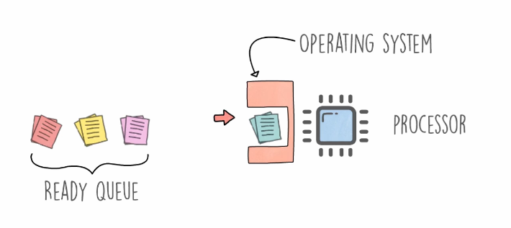
Process Scheduling
Process scheduling Remove the running process from the CPU and select another process on the basis of a particular strategy
Process scheduling is an essential part of a Multiprogramming operating system
More than one process can be loaded into the main memory at a time and loaded processes share the CPU one after the other using time multiplexing

Slide 147
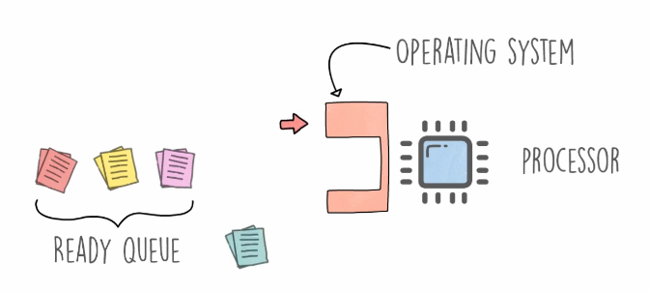
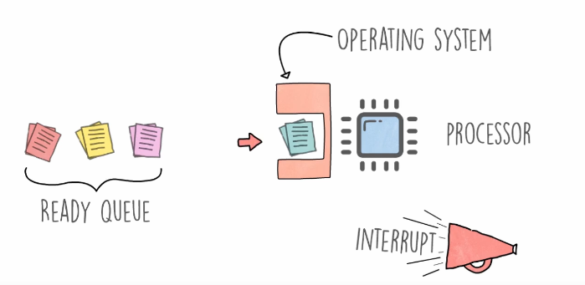
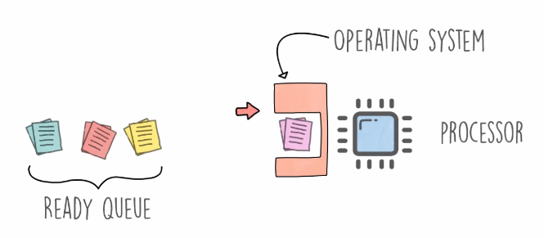
Process Scheduling
A process is running
An interrupt occurs (either in the running process, or the OS interrupts)
The operating systems moves the running process to the ready queue
The next ready process starts running

Slide 148
Scheduling Queues
Scheduling queues = Queues of processes or devices
When a process enters into the system, then this process is put into a scheduling queue (also called as job queue)
This queue consists of all processes in the system

Slide 149
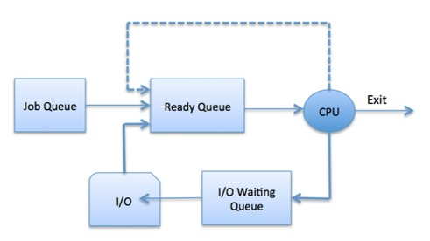
Process Scheduling

Slide 150
Scheduling Queues
A newly arrived process is put in the ready queue, waiting for the CPU
A running process could:
Issue an I/O request and then it would be placed in an I/O queue
Create new sub process and will wait for its termination
Be removed forcibly from the CPU, as a result of interrupt and put back in the ready queue

Slide 151
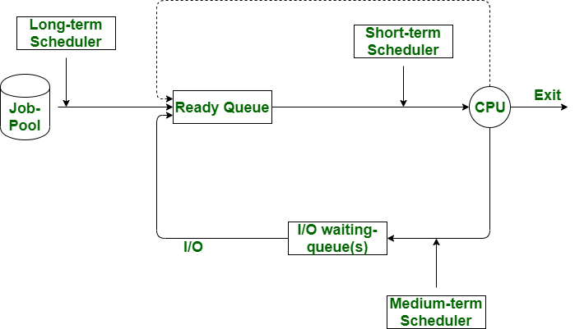
Scheduler Types
Scheduler: System software which handles process scheduling
Three types
Long Term Scheduler
Short Term Scheduler
Medium Term Scheduler

Slide 152
Long Term Scheduler
Long term scheduler: Job scheduler
Selects processes from the queue and loads them into memory for execution
Then they wait for CPU
Provides a balanced mix of jobs: I/O bound and processor bound
Controls the degree of multiprogramming (Number of new processes and departing processes)

Slide 153
Short Term Scheduler
Short term scheduler: CPU scheduler
Moves a ready process to the running state
Selects a process among the processes that are ready to execute and allocates CPU to one of them
Also known as dispatcher
Executes most frequently

Slide 154
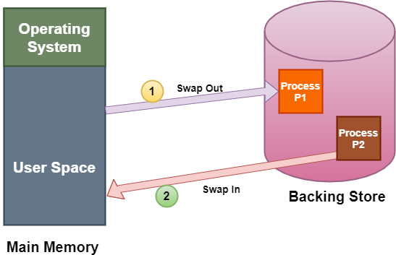
Medium Term Scheduler
Medium term scheduler: Performs swapping
A running process may become suspended if it makes an I/O request
Swapping: The medium tern scheduler moves the suspended process to the secondary storage

Slide 155
CPU Scheduling (i.e. Short Term Scheduling)
Resources: the things operated on by processes (CPU time, Disk space)
Resources can be:
Preemptive: OS can take resource away, use it for something else, and then give it back later (e.g. processor)
Non-preemptive: Once given, it cannot be reused until the process gives it back (e.g. file, terminal)
Anything is preemptive if it can be saved and restored

Slide 156
Criteria for a Good CPU Scheduling Algorithm
Fairness: Every process gets its fair share of CPU (i.e. time slice)
Efficiency (utilization): Keep CPU busy
Response time: Minimize response time for interactive users
Throughput: Maximize jobs per hour
Minimize overhead (Context switch)

Slide 157
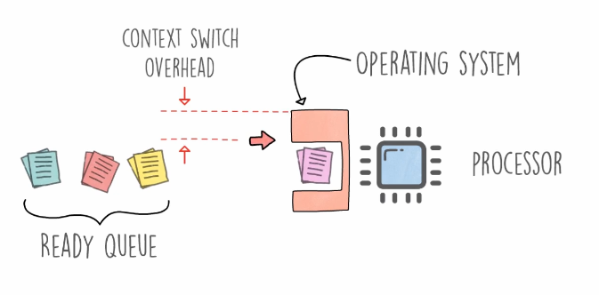
Context Switch

Slide 158
Process Timings
Arrival time: Time when the process arrived in the process queue
Burst time: The CPU time used by the process
Completion time: The time at which the process got completed
Turn around time: The time at which the process got completed minus the time at which the process entered the system
Waiting time: The time for which the process needed to wait, due to lack of CPU attention
Turn Around Time = Completion Time - Arrival Time
Waiting Time = Turnaround time - Burst Time OR Start of Last Burst Time – Time Spent in Bursts – Arrival Time

Slide 159
Important Point about Waiting Time
When using the second formula …
The calculation of waiting time will depend on whether or not we are given arrival time of the process
Two cases:
Arrival time not given: Waiting time = Start of last burst – Time spent in earlier bursts
Arrival time given: Waiting time = Start of last burst – Time spent in earlier bursts – Arrival time
Examples will clarify

Slide 160
Scheduling Algorithms
First-Come First-Served (FCFS)
Round Robin (RR)
Priority
Shortest Job First (SJF)
Preemptive algorithm: Can be interrupted by an operating system
Non-preemptive algorithm: Cannot be interrupted by an operating system even if there is a need to do so

Slide 161
First Come First Serve (FCFS)
First Come First Serve (FCFS): Also called First In First Out (FIFO)
Simplest: Executes the process that comes first
Non-preemptive
The arrival time of processes is deciding factor here
Easiest to implement

Slide 162
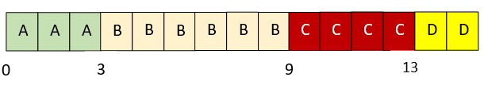
Example
Consider the following processes and draw a chart showing the FCFS execution
Process | Arrival Time | Processing Time
A | 0.000 | 3
B | 1.001 | 6
C | 4.001 | 4
D | 6.001 | 2

Slide 163
Example
Consider the following processes and calculate average turnaround time and waiting time in FCFS
Turnaround time = Terminated time – Arrival time
= ( (3-0) + (9-1) + (13-4) + (15-6) ) / 4 = 7.25
Waiting time = Start of last burst – Time spent in earlier bursts – Arrival time
A: 3 - 3 = 0 B: 3 - 1 = 2 C: 9 -4 = 5 D: 13 – 6 = 7
Process | Arrival Time | Processing Time
A | 0.000 | 3
B | 1.001 | 6
C | 4.001 | 4
D | 6.001 | 2

Slide 164
Round Robin (RR)
Round Robin (RR): Preemptive scheduling algorithm
Uses concept of time slice
Process at the beginning of ready queue gets chance to be executed first, but only for span of one time slice
Next process gets the chance, again for span of one time slice
Designed for time-sharing systems

Slide 165
Round Robin (RR) – Key Points
If Process burst < Time slice, then as soon as it is over, the CPU resources are released voluntarily
Example: time slice = 4 ms, Burst time = 2 ms
The next process in the ready queue occupies the CPU after 2 ms
If Process burst > Time slice, the timer will go off and the process is preempted
Example: time slice = 4 ms, Burst time = 8 ms
The next process in the ready queue takes over after 4 ms

Slide 166
Round Robin (RR) Example
Consider 4 processes where time slice is 3
Calculate average waiting time
Process | Burst time
P1 | 10
P2 | 2
P3 | 5
P4 | 6

Slide 167
Explanation
Process | Burst time
P1 | 10
P2 | 2
P3 | 5
P4 | 6
P1 is executed for 3ms. Then P2 is executed. As, P2 is only 2ms long, after 2ms, the next process occupies the CPU.
P3 then is executed for 3ms. So, P3 still needs 2ms. Then, P4 is executed for 3ms. P4 still needs 3ms.
P1 is again executed for 3ms. P1 still needs 4ms.
P3 is executed for 2ms. Then, P4 is executed for 3ms.
Now remaining process is P1 only. It executes for 3ms. After that, Since P2, P3 and P4 are already finished, P1 is executed again for remaining time (1ms).
Time slice = 3

Slide 168

Solution
P1 has utilized two 3ms time slices earlier, so we subtract 3 twice from its last start time
Here, we are not given process arrival times, so Waiting time = Start of last burst – Time spent in earlier bursts
Waiting time for P1 = 19-(3+3) = 13ms
Waiting time for P2 = 3ms
Waiting time for P3 = 14-3 = 11ms
Waiting time for P4 = 16-3 = 13ms
Total average waiting time = (13+3+11+13)/4 = 10ms
Both P3 and P4 have utilized one time slice each, earlier, so we subtract 3 from them

Slide 169
Exercise
Consider the following processes and using RR (time slice = 2), draw the execution chart and calculate average turnaround time and average waiting time
Process | Arrival Time | Processing Time
A | 0.000 | 3
B | 1.001 | 6
C | 4.001 | 4
D | 6.001 | 2

Slide 170
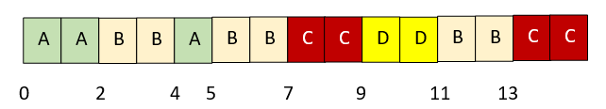
Solution
Process | Arrival Time | Processing Time
A | 0.000 | 3
B | 1.001 | 6
C | 4.001 | 4
D | 6.001 | 2
Here, we are given process arrival times, so Waiting time = Start of last burst – Time spent in earlier bursts – Arrival time
Explanation: When process A’s first time slice expires, process B runs. At time4, process A is restarted and process B returns to ready queue. At time 4.001, process C enters the ready queue after process B. At time 5, process A terminates and process B runs. At time 6.001, process D enters the ready queue behind process C. At time 7, process C, D, B, and C run in sequence.
Average turnaround time = Terminated time – Arrival time
( (5-0) + (13-1) + (15-4) + (11-6) ) / 4 = 8.25
Waiting time = Last burst start – Time spent in earlier bursts – Arrival time
A: 4 – 2 - 0 = 2 B: 11 – 4 – 1 = 6 C: 13 – 2 – 4 = 7 D: 9 – 6 = 3

Slide 171
Round Robin – Summary
Advantage:
Does not cause starvation, as all the processes get equal CPU time slices
Disadvantages:
Has an overhead of context switching
Too small time slices may cause overhead and slower execution of processes

Slide 172
Priority Scheduling
Priority scheduling: Non-preemptive algorithm
Designed for batch systems
The process priorities are compared and processes are scheduled accordingly
Important: Read the question carefully: Priority 0 = Highest or Lowest?

Slide 173
Example
For the processes listed below, draw a chart showing their execution using priority scheduling. A larger number has higher priority. Consider (a) Preemptive and (b) Non-preemptive cases separately. Consider higher priority number = higher priority.
Process | Arrival time | Burst time | Priority
A | 0.000 | 4 | 3
B | 1.001 | 3 | 4
C | 2.001 | 3 | 6
D | 3.001 | 5 | 5

Slide 174
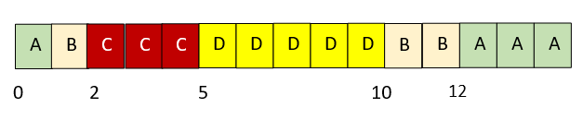
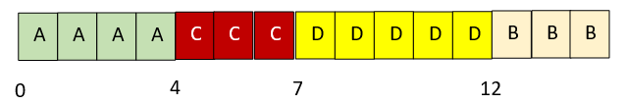
Solution
Preemptive case
Non-preemptive case
Process A runs until process B arrives. Process B preempts process A and runs until it is preempted by process C. After process C terminates, process D runs. After process D, the lower-priority process B and process A run.
Process A runs to completion. When it terminates, the other three processes are all waiting to run. They run in the order of their priority: C, D, and B.

Slide 175
Problem
For the same processes, calculate turnaround time for each process using priority scheduling
Preemptive
A: 15 – 0 = 15 B: 12 – 1 = 11 C: 5 – 2 =3 D: 10 – 3 = 7, Avg = (15 + 11 + 3 + 7) / 4 = 9
Non-preemptive
A: 4 – 0 = 4 B: 15 – 1 = 14 C: 7 – 2 = 5 D: 12 – 3 = 9, Avg = (4 + 14 + 5 + 9) / 4 = 8
Process | Arrival time | Burst time | Priority
A | 0.000 | 4 | 3
B | 1.001 | 3 | 4
C | 2.001 | 3 | 6
D | 3.001 | 5 | 5

Slide 176
Priority Scheduling – Points
A process having lower priority can be indefinitely blocked or starved
To prevent this, we do aging, where the priority of the process is increased as it waits in the queue
So, a process which has been in a queue for a long time will reach high priority, and hence it will not be starved

Slide 177
Shortest Job First (SJF)
Shorted Job First (SJF): Non pre-emptive algorithm
Selects the process with the shortest expected processing time
If there is a tie, FCFS is used
Favors short processes over longer ones
Can lead to starvation for a long process in extreme cases

Slide 178
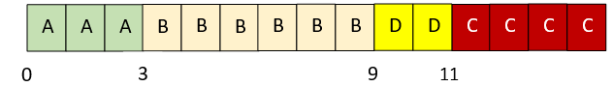
Example
Consider the following processes and draw a chart showing the SJF execution
Process | Arrival Time | Processing Time
A | 0.000 | 3
B | 1.001 | 6
C | 4.001 | 4
D | 6.001 | 2
Explanation: A starts executing; it is the only choice at time 0. At time 3, B is the only process in the queue. At time 9, when B completes, process D runs because it is shorter than process C.

Slide 179
Example
Consider the following processes and calculate average turnaround time and waiting time for each process using the SJF algorithm
Turnaround time: ((3 – 0) + (9 – 1) + (15 – 4) + (11 – 6) / 4) = 6.75
Waiting time: A: (3 – 3 - 0) = 0; B: (3 – 0 - 1) = 2; C: (11 – 0 - 4) = 7; D: (9 – 0 - 6) = 3
Process | Arrival Time | Processing Time
A | 0.000 | 3
B | 1.001 | 6
C | 4.001 | 4
D | 6.001 | 2

Slide 180
Linux Processes
Process types: Parent, Child, Daemon, Zombie (Defunct), Orphan
Try command: ps -ef | less … e = All processes, f = Full-format
Note that the first process is init with pid 1
Zombie: A terminated process whose data has not been released
Orphan: A child process whose parent process has terminated before it is terminated (e.g. while ls is running, we close the terminal)
Daemon: Long-running, independent processes such as sshd, httpd, etc
fork() system call
Parent process
Child process
fork() system call
ls command
bash
Directory listing

Slide 181
Foreground and Background Processes
By default, all the processes are foreground processes
When a process runs in the foreground, no other process can run in the terminal until the process is terminated or killed
When we add an ampersand (&) to a foreground command, it is run as a background process
When a process runs in the background, another process can run in the foreground

Slide 182
Example
atul@lubuntu:~$ sleep 10
atul@lubuntu:~$ sleep 60 &
[1] 1150
atul@lubuntu:~$ echo "hello there"
hello there
atul@lubuntu:~$ jobs
[1]+ Running sleep 60 &
atul@lubuntu:~$ fg
sleep 60
What are we doing?
Start a process in the foreground
Then start a process in the background
Then run another process in the foreground
Check that the background process is still running
Finally, bring the background process to the foreground

Slide 183
Linux Process Management Commands
ps … Process status
PID TTY TIME CMD
1524 pts/0 00:00:00 bash
1907 pts/0 00:00:00 ps
ps -ef … all processes, full output
UID PID PPID C STIME TTY TIME CMD
root 1 0 0 15:12 ? 00:00:02 /sbin/init splash
root 2 0 0 15:12 ? 00:00:00 [kthreadd]

Slide 184
Linux Process Management Commands
Finding all processes started by a user
ps -u atul
Display a tree-like representation of processes
pstree
pstree -p 1234 … for a particular process
Dynamically changing information
top … q to quit

Slide 185
Signals and Killing Processes
Kill a process: the kill command
sudo kill <pid>
sudo kill 1947
[sudo] password for atul:
kill -l … List all the signals related to the kill command
Signal: Asynchronous message sent to a process

Slide 186
Signals and Kill Example
From the Ubuntu start button -> Accessories -> Kcalc
Come back to the terminal: pgrep -l kcalc … process grep
It will show the PID for the kcalc program … say 1208
Then kill -2 1208 … Send the SIGINT signal (2) to PID 1208
It will kill the calculator program
SIGNIT = Interrupt, same as Ctrl+C

Slide 187
Signals and Kill Example – Different Syntax
Now start Firefox
Come back to the terminal: pidof firefox … Even simpler
It will show the PIDs for firrfox … say 2028 2015 1996 …
Then kill -INT 2028 2015 1996 …
Same result
Even shorter: kill –SIGNIT $(pidof firefox)

Slide 188
Memory Management

Slide 189
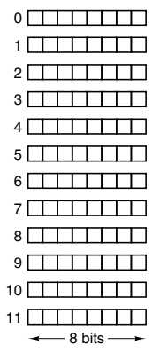
Memory
Memory: Place where programs and data are stored
Consist of a number of cells, each storing a piece of information
Each cell has an address
If a memory has n cells, they will have addresses 0 to n − 1
All cells in a memory contain the same number of bits

Slide 190
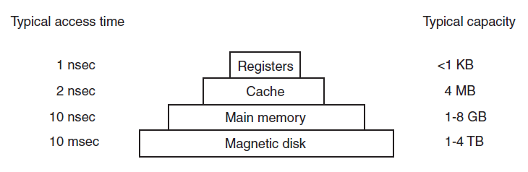
Memory Hierarchy
Fastest access, Most expensive
Slowest access, Least costly

Slide 191
Memory Types
Random Access Memory (RAM): Memory from where data can be read and where data can be written at any random location
Static RAM (SRAM)
Dynamic RAM (DRAM)
Read Only Memory (ROM): Memory from where data can be read, but not where data can be written
Useful for booting up, fixed data (e.g. electronic devices)

Slide 192
Static RAM (SRAM)
Static RAMs (SRAMs): Constructed internally using circuits similar to a flip-flop
Retain their contents as long as the power is kept on: seconds, minutes, hours, even days
Very fast
A typical access time is a nanosecond or less
Popular as cache memory (fast memory between the CPU and RAM)

Slide 193
Dynamic RAM (DRAM)
Dynamic RAMs (DRAMs): Do not use flip-flops
An array of cells, each cell containing one transistor and a tiny capacitor
Must be refreshed every few milliseconds to prevent data loss
Need only one transistor and one capacitor per bit (vs six transistors per bit for the best static RAM)
So, main memories are created using dynamic RAM
Slow (access time of tens of nanoseconds)

Slide 194
Read Only Memory (ROM)
Read Only Memory (ROM): The data are inserted during manufacture
Contents cannot be modified
Much cheaper than RAMs
Inflexible, because they cannot be changed after manufacture

Slide 195
Relocation
Note that both processes have their own address space starting from 0 to some number
Physical memory (RAM)
Address space: Set of addresses that a process can use to address memory
Each process has its own logical address space
Dynamic relocation maps the address space of each process onto a different part of physical memory (i.e. RAM)
Process P2
Address space: 0 to 1000
Address 6000
Address 5000
Process P1
Address space: 0 to 3500
Address 4000
Address 3000
Address 2000
Address 1000
But the real physical addresses are different
Address 0

Slide 196
Base and Limit Register
Two CPU registers are used to track this
When a process is run:
The base register is loaded with the physical address where its program begins in memory
The limit register is loaded with the length of the program
Every time a process references memory, the CPU hardware automatically adds the base value to the address generated by the process
It also ensures that this value is less than that in the limit register
For our previous diagram:
When process P1 is run:
Base register = 0
Limit register = 3500
When process P2 is run:
Base register = 4000
Limit register = 5000
Now consider that process P2 has referenced memory location 300
The CPU hardware will add the base register value to it, making the address 4300
But before accessing physical memory location 4300, it will also verify that this is less than the limit register value of 5000

Slide 197
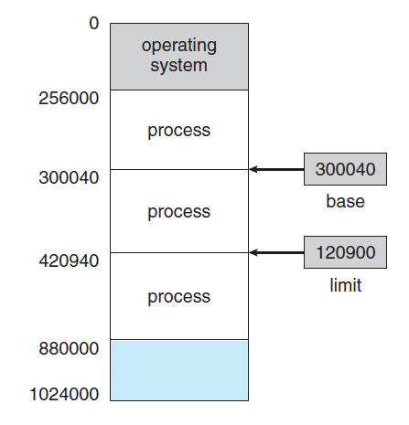
Memory and Protection: Example
If the base register contains 300040 and limit register contains 120900, then the program can legally access all addresses from 300040 to 420939.

Slide 198
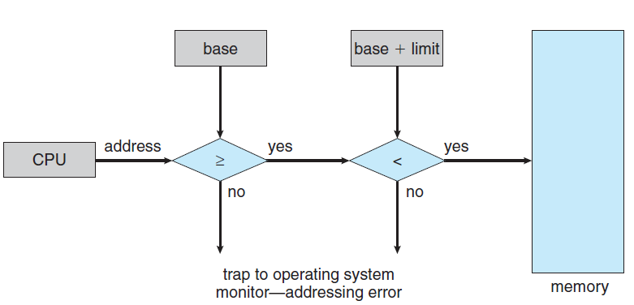
Trap
A program executing in user mode may try to access operating-system memory or other users’ memory
Results in a trap
Fatal error

Slide 199
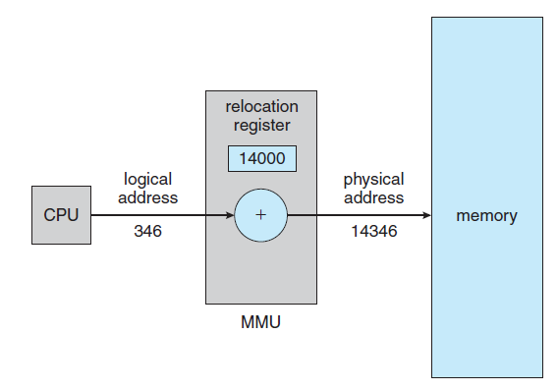
Logical and Physical Address Space
Base register is now called relocation register
Address generated by the CPU: Logical address (or virtual address),
Address seen by the memory unit: Physical address
Virtual-to-Physical address mapping is done
Actual Physical memory address = Base/Relocation register value + Logical address generated by the user process

Slide 200
Contiguous and Dynamic Memory Allocation

Slide 201
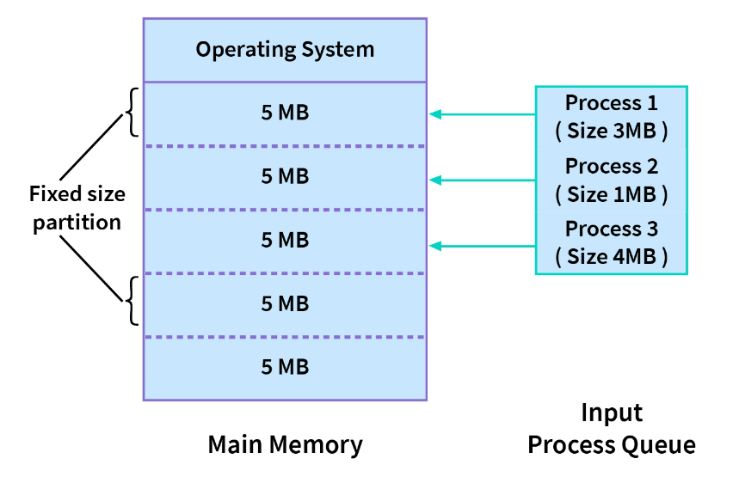
Contiguous Memory Allocation
Memory has two partitions: (1) Operating system (2) User processes
Contiguous memory allocation: Each process is allocated a single section of memory that is contiguous to the section containing the next process
Types: Fixed-size partitions (diagram) or Variable-size partitions (different sized partitions)

Slide 202
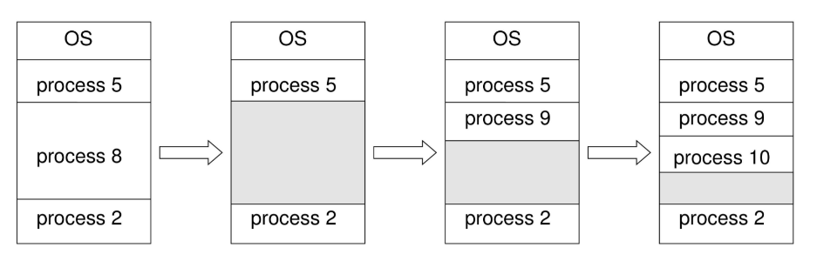
Dynamic Memory Allocation
Dynamic memory allocation: Memory is not allocated contiguously to the incoming processes
Approaches:
First fit. Allocate the first big enough free block
Best fit. Allocate the smallest free block that is large enough
Worst fit. Allocate the largest free block
Process 8 goes out, 9 and 10 come in

Slide 203
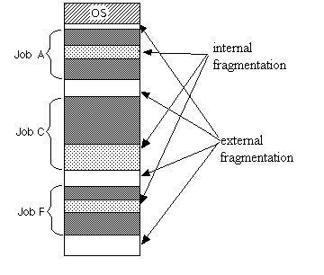
Fragmentation
External fragmentation: Memory blocks available in the memory are not too small and non-contiguous
Internal fragmentation: Unused memory inside a partition, because a process does not fully utilize the allocated memory

Slide 204
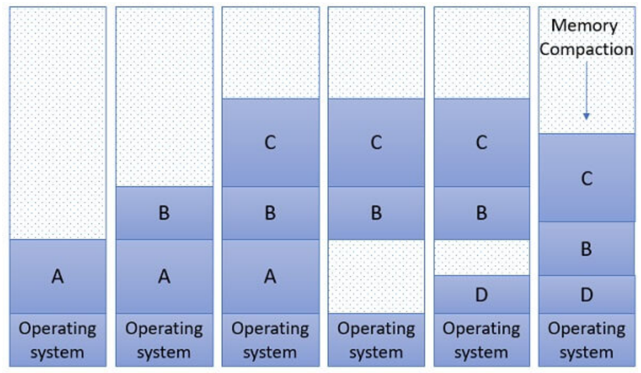
Compaction
Compaction: Reduce external fragmentation
Aim: Shuffle memory contents to place all free memory together in one large block
Not always possible

Slide 205
Segmentation

Slide 206
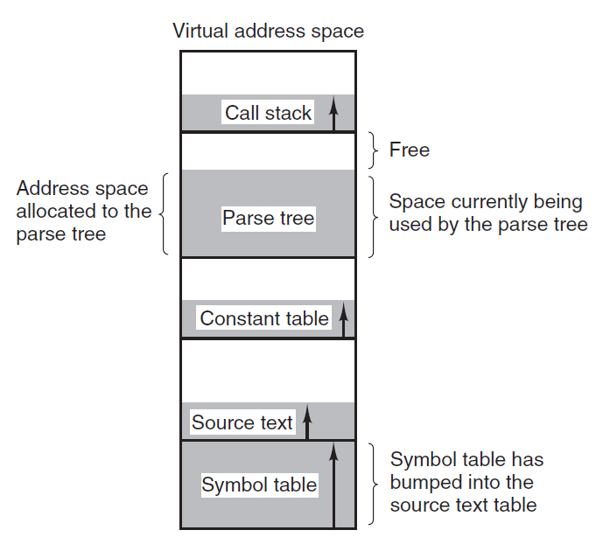
Segmentation
When a compiler compiles a program, it uses many tables: symbol table, source text, constants, parse tree, call stack, …
Memory needs of these tables are different (not of the same size)
Here, it is better to provide the computer with many completely independent address spaces, called as segments

Slide 207
Segmentation
Segmentation: Main memory is considered to be made up of a collection of segments
Logical address of a segment has two parts: segment number and offset
Each segment is a linear sequence of addresses from 0 to some maximum value
A segment is a logical entity
Different segments can have different lengths, capped by the maximum value mentioned above
Segment lengths can change during program execution, if necessary
So, different segments can grow or shrink without affecting other segments

Slide 208
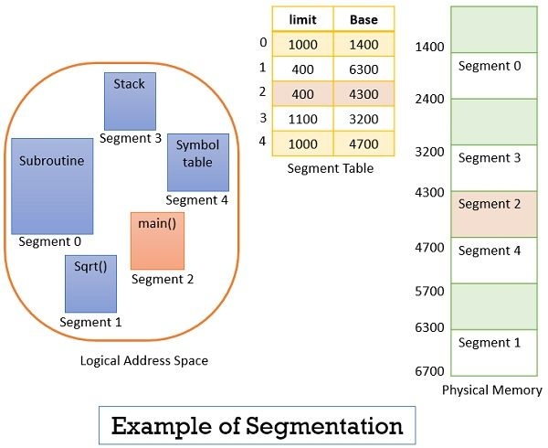
Segmentation Example
Consider a user program divided into five segments, numbered 0 to 4

Slide 209
Segmentation Example
Suppose the CPU calls for segment number 2, whose length is 400 bytes, starting at physical memory address 4300
The CPU wants to read the 53rd byte in this segment
So, the CPU informs the operating system that I want data at segment number 2, offset 53
The offset 53 is between 0 and the limit of the segment, which is 400
So, the operating system will read this byte as: Base register + Offset for the given segment, which is: 4300 + 53 = Byte at physical memory location 4353

Slide 210
Virtual Memory and Paging

Slide 211
Virtual memory – The need
Suppose we have kept a capacity of 20 digits in the phone number, but actually phone numbers are only of 10 digits
Numbers will be of this type: 00000-00000 91910-33333
Consider a computer that has 16-bit memory addresses, but actual physical memory of 4096 bytes
Addressable memory: 2¹⁶ = 65,536 addresses, but only 0-4095 are useful, 4096-65535 will be unreachable
See the next slide

Slide 212
Main Memory and Addressable Memory
Memory address 65535
Memory address 65534
…
…
Memory address 4095
Memory address 0
Unusable addresses
Memory address 4095
Memory address 4094
…
…
…
Memory address 0
Physical memory
Addressable memory

Slide 213
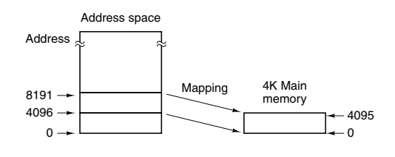
Separating address space and memory locations – Virtual Memory!
Bring 4096 bytes of addressable memory into the physical memory at a time
Example: Bytes 0 to 4095 or 4096 to 8191, etc (only one such block at a time)
Addressable memory
Real/physical memory (RAM)

Slide 214
Virtual Memory – Benefits
Programmer’s view of memory: Locations 0 to 65535 (Virtual address space)
Real memory: Locations 0 to 4095 (Physical address space)
Page table or Page map table: Maps virtual address to physical address

Slide 215
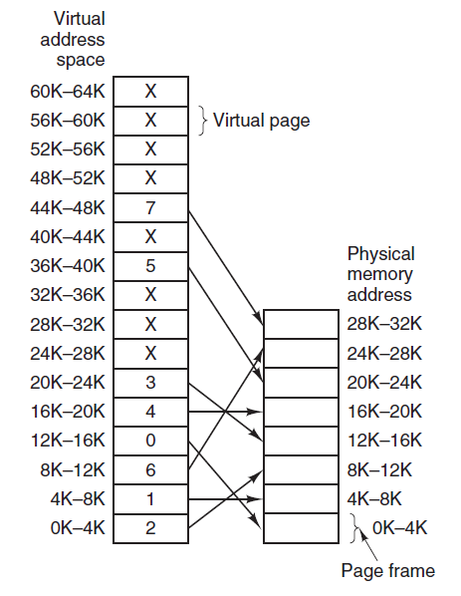
Page Mapping Table or Page Table
Virtual memory
Physical memory

Slide 216
Page Replacement – Basic idea
Page fault: Program refers to a virtual memory address that is not present in the physical/real main memory
Working set: Set of pages that a program is actively and heavily using
Page replacement policy: Decides how to handle page faults
Least Recently Used (LRU): Evicts the page least recently used
First In First Out (FIFO): Removes the least recently loaded page
Thrashing: A program that generates page faults frequently
Demand paging: Load pages only on demand, not in advance
Dirty bit: Tells the OS if the page contents were modified, so as to not lose the changes in the event of page replacement

Slide 217
Shared Pages
Multiprogramming environment: Several users may run the same program at the same time
Separate pages into code and data
Shared pages: Share code pages, do not share data pages
Re-entrant code = Read-only code
For code to be re-entrant, it must not contain any data that can be modified by a process

Slide 218
Throttling
Throttling: Operating system intentionally limits or controls certain resources or processes to prevent excessive consumption
Examples: CPU usage, memory usage, network bandwidth, and other system resource

Slide 219
Deadlocks

Slide 220
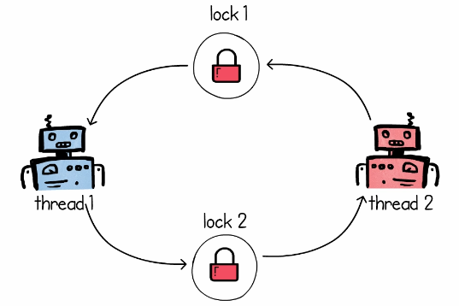


Deadlock
Step 1: Thread 1 asks for Lock 1 on resource R1, Thread 2 asks for Lock 2 on resource R2 – both are successful
Step 2: Soon after, they want a lock on the resource that the other thread has locked
Result: Deadlock

Slide 221
Four Simultaneous Necessary Conditions for a Deadlock
Mutual exclusion. Only one process can use a resource
Hold and wait. A process must be holding at least one resource and waiting to acquire additional resources that are currently being held by other processes
No preemption. Resources cannot be preempted; that is, a resource can be released only voluntarily by the process holding it
Circular wait. A set {P0, P1, ..., Pn} of waiting processes must exist such that P0 is waiting for a resource held by P1, P1 is waiting for a resource held by P2, ..., Pn−1 is waiting for a resource held by Pn, and Pn is waiting for a resource held by P0

Slide 222
Deadlock Prevention and Avoidance
Deadlock prevention: Never allow all the four deadlock conditions to become true
Deadlock avoidance: Allocate resources to only one process at a time

Slide 223

Deadlock Prevention
Condition 1: Mutual exclusion
For a deadlock to occur, at least one resource must be non-sharable (i.e. mutual exclusion condition must become true)
Consider a read-only file – it is sharable – processes do not require an exclusive lock on it
However, how can we practically mandate that all the resources be sharable?
Hence, avoiding mutual exclusion is very difficult

Slide 224
Deadlock Prevention
Condition 2: Hold and wait
Whenever a process requests a resource, it does not hold any other resources. Two approaches can be used to handle this:
Each process must request and be allocated all its resources before it begins execution
Allow a process to request resources only when it has none
Main disadvantages
Resource utilization may be low, since resources may be allocated but unused for a long period
Starvation is possible. A process that needs several popular resources may have to wait indefinitely, because at least one of the resources that it needs is always allocated to some other process

Slide 225
Deadlock Prevention
Condition 3: No pre-emption
If a process is holding some resources and requests another resource that cannot be immediately allocated to it, then all resources the process is currently holding are preempted
The process will be restarted only when it can regain its old resources, as well as the new ones that it is requesting
This protocol is often applied to resources whose state can be easily saved and restored later, such as CPU registers and memory space

Slide 226
Deadlock Prevention
Condition 4: Circular wait
Impose a total ordering of all resource types and to require that each process requests resources in an increasing order of enumeration
Suppose our numbering for resources is Tape drive = 1, Disk drive = 5, Printer = 12
Now a process that needs the tape drive and the printer at the same time must first request the tape drive and then the printer

Slide 227
Deadlock Avoidance
Ask for additional information about how resources are to be requested
Example: We must know that process P will request first the tape drive and then the printer before releasing both resources, whereas process Q will request first the printer and then the tape drive
Now we know whether a deadlock is possible or not

Slide 228
Semaphore
Semaphore: A variable used to control access to a common resource
Keeps a count of resource usage and decides if the resource can be made available to a requesting process
Two types
Counting semaphore: Can be any number
Binary semaphore: Semaphore with a value of 0 or 1 only
The Producer-Consumer Problem can be solved using semaphores
Threads and processes perform wait() and signal() operations to indicate whether they are acquiring or releasing resources

Slide 229
Semaphore Example
We define a semaphore availableCopies to store the number of available copies of a book = 10
Student needing a copy calls the wait() method – Will decrement the semaphore, assuming it is not already 0
Student returning a copy calls the signal() method – Will increment the semaphore

Slide 230
Producer-Consumer Problem
Producer-consumer problem: Also called bounded-buffer problem
Two processes share a common fixed-size buffer
The producer puts information in
The consumer takes it out
If the producer wants to write more information but the buffer is full, the producer goes to sleep and is woken up when the consumer removes one or more items from the buffer
If the consumer wants to read more information but the buffer is empty, the consumer goes to sleep and is woken up when the producer adds one or more items to the buffer

Slide 231
Mutual Exclusion (Mutex)
Mutual Exclusion (Mutex): An object that allows multiple program threads to share the same resource, such as a file, but not simultaneously
Different from semaphores
Semaphore = Signaling mechanism, Mutex = Locking mechanism
Semaphore: May or may not be binary, Mutex: Always binary
Example follows …

Slide 232

Need for Synchronization
Consider two people, who have access to the same bank account
The first one keeps adding money, the second one keeps spending money
Initial balance is $100

Slide 233





Need for Synchronization
Step 1: Stingy adds $10
Step 2: Spendy immediately spends the $10
Step 3: Both read the balance
Step 4: Both update balance (WRONG! Final balance should be $100)

Slide 234

Race Condition
Because $20 were added and spent, the final balance should have been $100
But it is not – this is called as race condition

Slide 235




Using Mutex
Step 1: Stingy would ask for a lock (mutex)
Step 2: Since no one is holding the mutex, Stingy gets it
Step 3: Stingy thread updates balance and releases mutex
Step 4: Now if Spendy locks it, updated balance will be seen

Slide 236


What if a Locked Resource is Wanted by Another Thread?
Currently, the spendy thread is holding mutex on the balance and stingy again wants the mutex … It must go to sleep and wait till spendy releases it!

